Slide 1

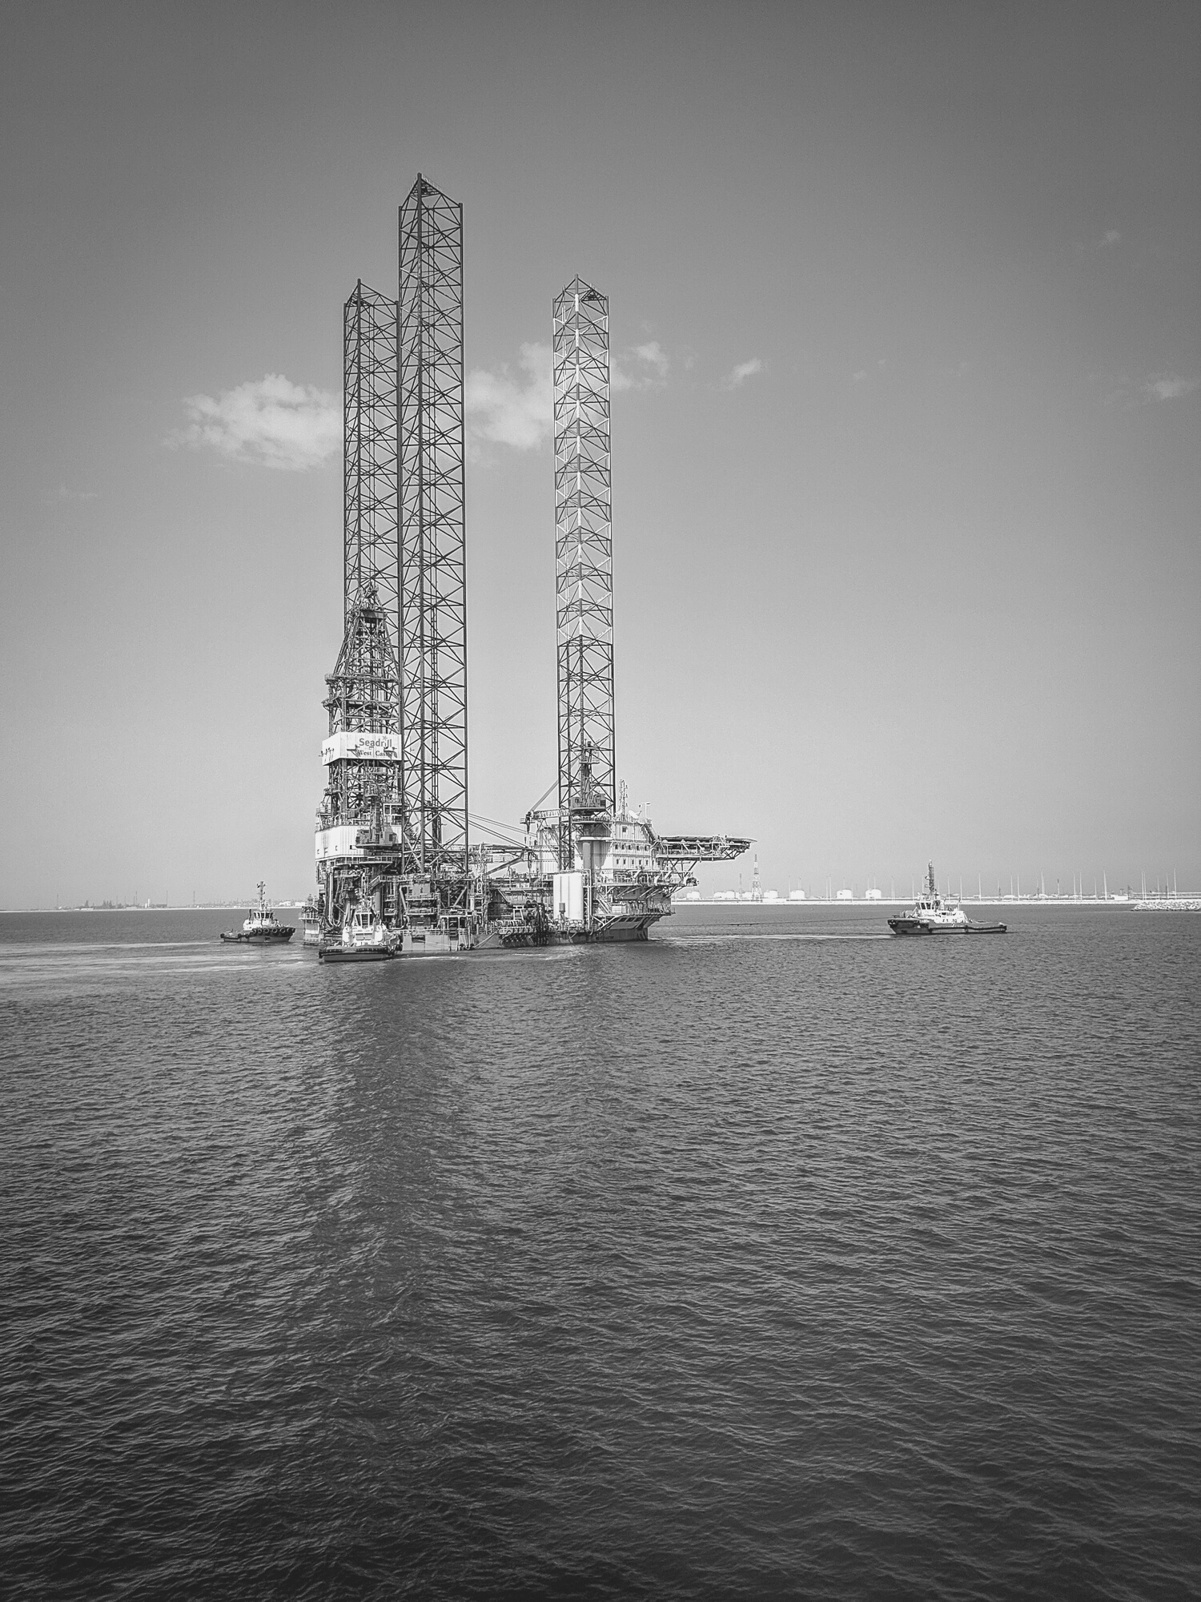

Seminar Group 3 Team 1
Oil Pipeline Safety Solutions
Members: Boslyn, Qin Zhi, Haziq, Ian, Jo Wee

Slide 2


Table Of Contents
Business Problem
Data Cleaning and Preprocessing
Models
Business Solutions
Conclusion

Slide 3


Business Problem

Slide 4





Enhancing Workplace Safety at ARAMCO
Jo Wee
World’s 2nd largest reserve: Over 270 billion barrels
$170 billion a year spent on costs related to occupational injuries (Samir, 2022)
Facing global challenges in workplace safety: 340 million reported cases annually
Important for ARAMCO to invest in proactive safety measures
Notes:
Samir, S. (2022, January 16). Economic costs of safety policy in the oil and gas industry: Egypt Oil & Gas. Egypt Oil & Gas | Connecting The Pieces. https://egyptoil-gas.com/features/economic-costs-of-safety-policy-in-the-oil-and-gas-industry/

Slide 5

Current Solutions
Jo Wee
Multilingual Safety Campaign
Aims to mitigate over 90% of injury-caused accidents
Prone to translation inaccuracies

Slide 6
Opportunity Statement
Jo Wee
GOALS:
Identify root causes of high accident rates in the oil pipeline sector
METHOD:
Utilize data analytics to predict accident severity and suggest recommendations
OUTCOMES
Enhanced employee safety
Economic cost savings from mitigated business expense
Notes:
Samir, S. (2022, January 16). Economic costs of safety policy in the oil and gas industry: Egypt Oil & Gas. Egypt Oil & Gas | Connecting The Pieces. https://egyptoil-gas.com/features/economic-costs-of-safety-policy-in-the-oil-and-gas-industry/

Slide 7
Methodology
Jo Wee
Data Cleaning and
Exploratory Data Analysis
Y Variables Selection
Model Building
Model Evaluation
Logistic Regression 1
Oil Pipeline Dataset
2,795 entries
48 variables
Injuries
CART 1
Categorical:
Accuracy %, True Positive
Continuous:
RMSE, R²
Logistic Regression 2
Data Cleaning
Fatalities
CART 2
Oil Pipeline Dataset
2,795 entries
31 variables
newcost
CART 3
Linear Regression 1
Notes:
Samir, S. (2022, January 16). Economic costs of safety policy in the oil and gas industry: Egypt Oil & Gas. Egypt Oil & Gas | Connecting The Pieces. https://egyptoil-gas.com/features/economic-costs-of-safety-policy-in-the-oil-and-gas-industry/

Slide 8
Data Cleaning & Preprocessing
1. Remove irrelevant variables 2. Handle missing values
3. Numeric to Categorical Conversion 4. Winsorization of All Costs

Slide 9


Ian
About the Dataset
This database includes a record for each oil pipeline leak or spill reported to the Pipeline and Hazardous Materials Safety Administration from 2010 to 2017. These records include the incident date and time, operator and pipeline, cause of incident, type of hazardous liquid and quantity lost, injuries and fatalities, and associated costs.

Slide 10
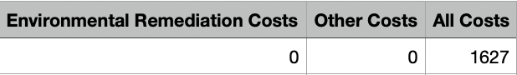
Ian
Database.csv (2795 rows and 48 columns)
Index
Accident Time/Date/Year
Operator Details
Pipeline Details
Liquid Details
Location
Causes
Oil Barrels
Ignition/
Explosion
Shutdown/
Restart/ Public Evacuations
Injuries
Fatalities
Costs

Slide 11
Ian
Database.csv (2795 rows and 48 columns)
Index
Accident Time/Date/Year
Operator Details
Pipeline Details
Liquid Details
Location
Causes
Oil Barrels
Ignition/
Explosion
Shutdown/
Restart/ Public Evacuations
Injuries
Fatalities
Costs

Slide 12
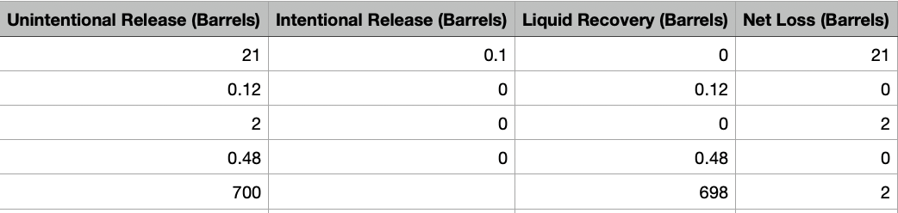
Ian
Oil Barrels
Unintentional Release + Intentional Release - Liquid Recovery = Net Loss
Some entries have Net Loss incorrectly calculated
NAs in Intentional Release

Slide 13
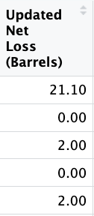
Ian
Oil Barrels
0
Intentional Release = Net Loss + Liquid Recovery - Unintentional Release
Net Loss is recalculated to Updated Net Loss (2 d.p)
Assuming no errors in Unintentional Release, Liquid Recovery and Net Loss, NAs in Intentional Release are replaced with appropriate values

Slide 14

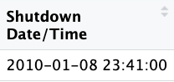
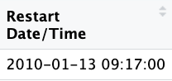



Ian
Shutdown and Restart Date/Time
lubridate
Shutdown and Restart Date/Time are dropped after Shutdown Duration (Hours) is calculated

Slide 15
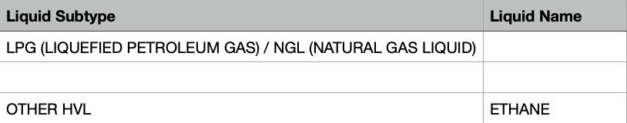
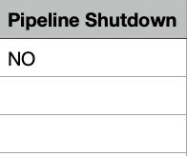
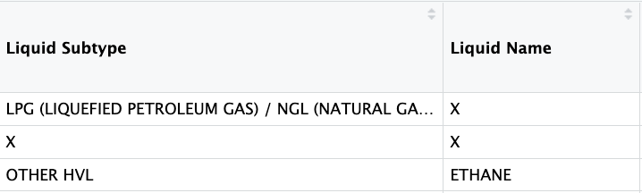
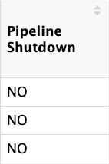
Ian
Other NA values
NA values in Liquid Subtype and Liquid Name are replaced with “X”
NA values in Pipeline Shutdown are replaced with “NO”

Slide 16

Ian
Other NA values
NA values in all the costs types are replaced with 0 because All Costs are calculated correctly with the remaining non-NA variables

Slide 17
Ian
Numeric to Categorical Conversion
Year (2010 - 2017)
Fatalities (True/False)
Injuries (True/False)
Public Evacuations (True/False)
Fatalities, Injuries and Public Evacuations are converted into factor because the severity of such variables dictates that the presence of such variables is more important than the frequency
Extra variables regarding Fatalities and Injuries are dropped

Slide 18
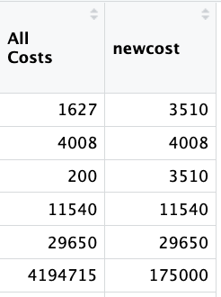
Ian
Winsorization of All Costs
All Costs has many extreme outliers which will affect model accuracy
Winsorization = Replace outliers with 5th or 95th percentile
Winsorization is saved as new variable called “newcost”

Slide 19
Exploratory Data Analysis
Univariate and Bivariate

Slide 20
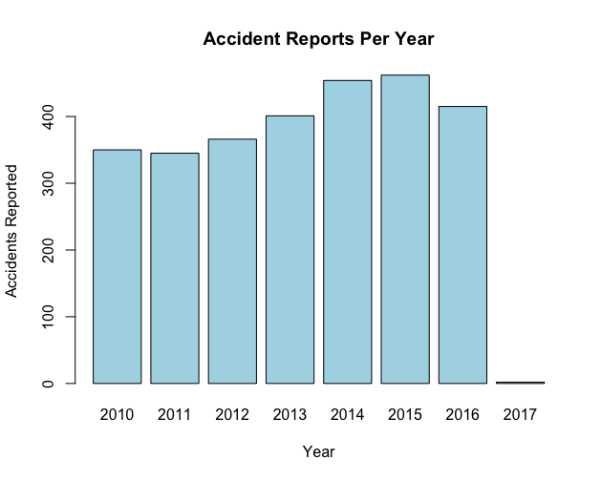
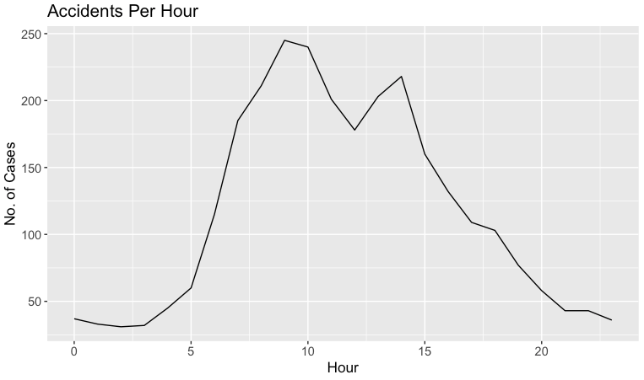
Univariate Analysis
Haziq
Number starts to increase at 5AM
Peak is approximately at 8AM
Increasing trend of accidents reported
Little data in 2017 as da

Slide 21
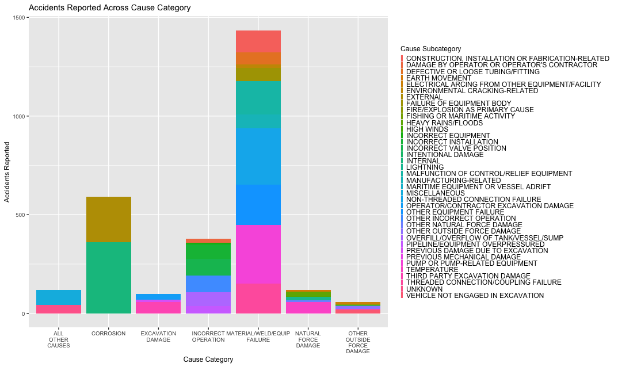
Univariate Analysis
Haziq

Slide 22
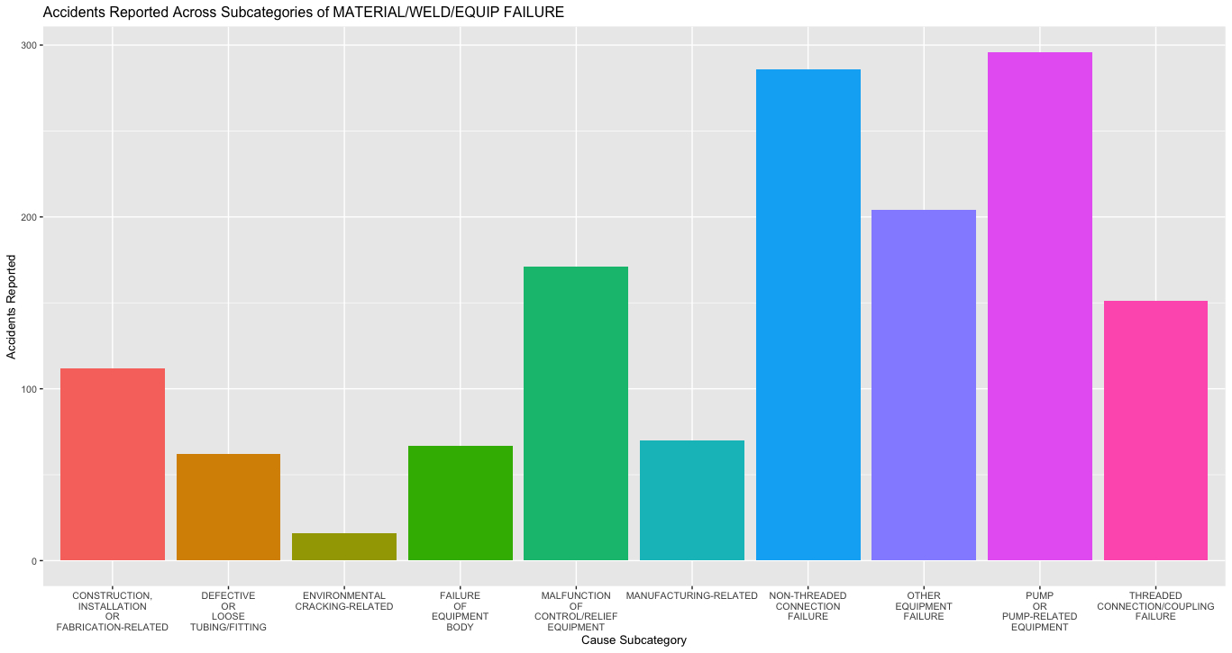
Univariate Analysis
Haziq
Highest number of accidents reported in ‘PUMP OR PUMP-RELATED EQUIPMENT’ subcategory

Slide 23
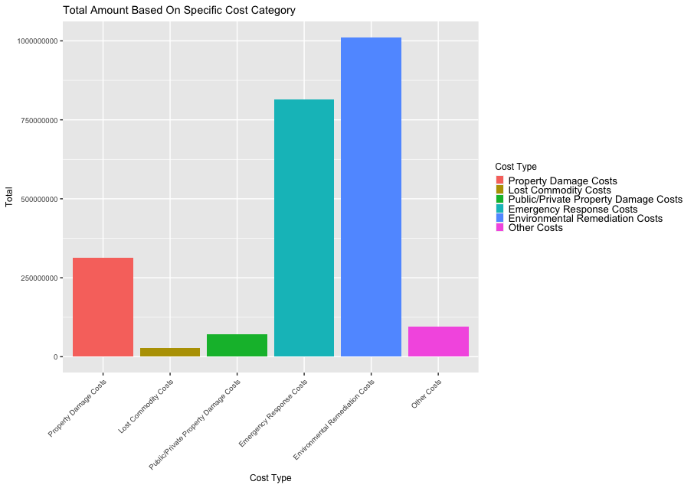

Univariate Analysis
Haziq
Highest amount of cost incurred is ‘Environmental Remediation Cost’
Introduced use of class weights in model to alleviate imbalanced data

Slide 24
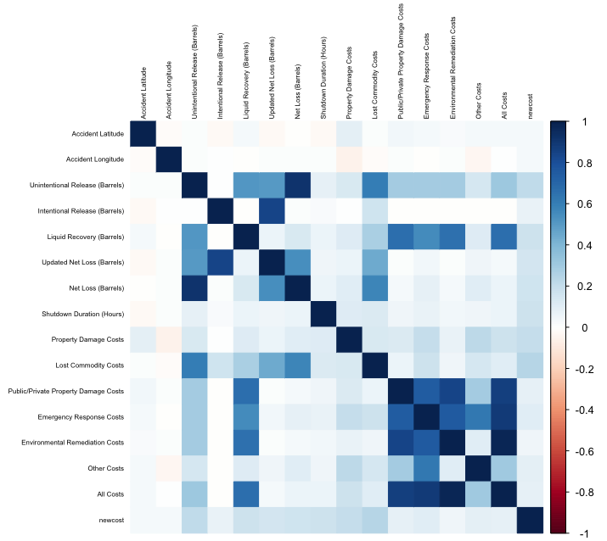
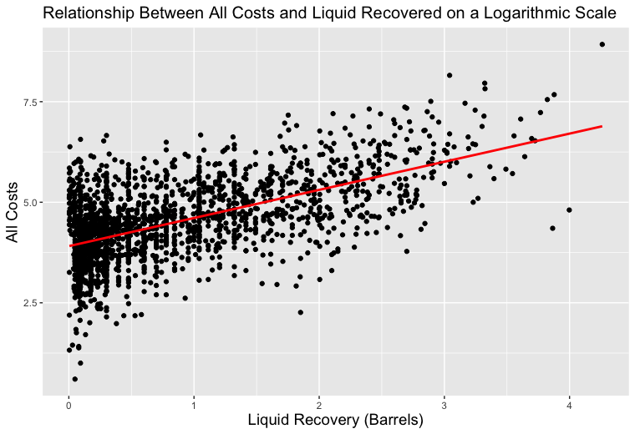
Bivariate Analysis
Haziq
‘Liquid Recovery’ and ‘All Costs’ have positive correlation
Recovery efforts are scaled according to accident severity

Slide 25
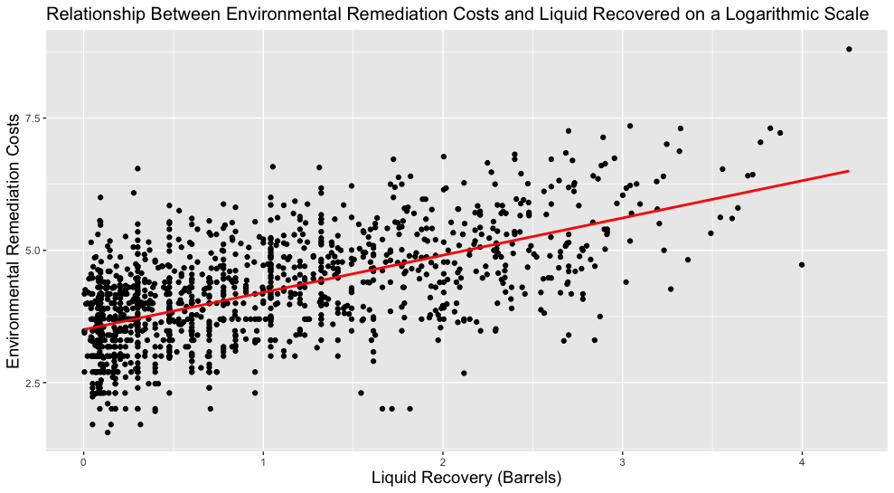
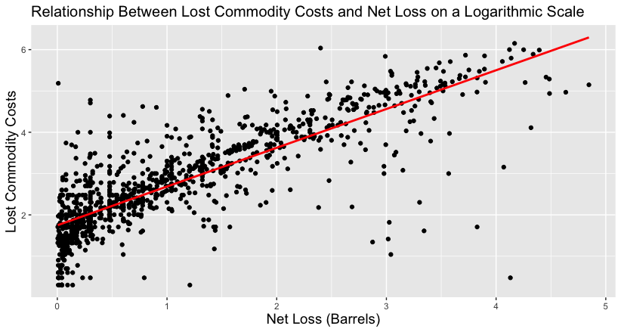
Bivariate Analysis
Haziq
Positive correlation between ‘Liquid Recovery’ and ‘Environmental Remediation Costs’
Positive correlation between ‘Lost Commodity Costs’ and ‘Net Loss’ (of liquid)

Slide 26
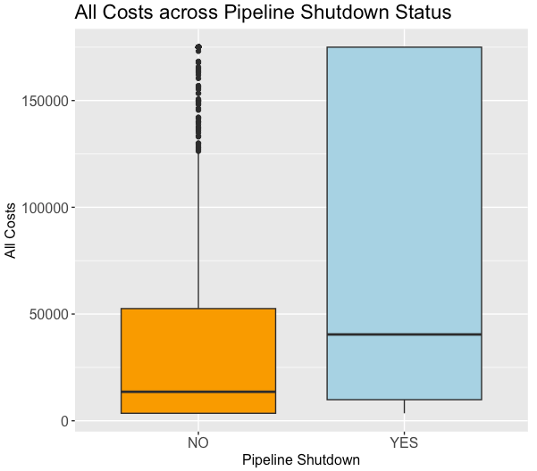
Bivariate Analysis
Haziq
Total costs of accidents that did cause pipeline shutdown are significantly higher on average

Slide 27
Models Developed
Response Variables: Injuries, Fatalities and newcost_Percentile

Slide 28
Response & Predictor Variables:
Boslyn
Injuries
Fatalities
newcost_Percentile
Cause Category
Pipeline Location
Pipeline Type
Liquid Type
Liquid Subtype
Shutdown Duration (Hours)
Liquid Ignition
Liquid Explosion
Evacuations
Fatalities
Updated Net Loss (Barrels).
Cause Category
Pipeline Location
Pipeline Type
Liquid Type
Liquid Subtype
Shutdown Duration (Hours)
Liquid Ignition
Liquid Explosion,
Evacuations
Injuries
Updated Net Loss (Barrels).
Final X variables:
Cause Category
Pipeline Type
Liquid Type
Shutdown Duration (Hours)
Liquid Explosion
Evacuations
Injuries
Updated Net Loss (Barrels)
Pipeline Shutdown.

Slide 29


Logistic Regression: Response Variable - Fatalities
Boslyn
Criteria to define factors as statistically significant and has a positive relationship with Fatalities:
P-value: < 0.001
Coefficient in logistic regression > 0
Statistically significant factors:
Cause Category: Other Outside Force Damage
Liquid Subtype: Other Highly Volatile Liquid (HVL)
Confusion Matrix of Test Set
Business Solutions
 |  | Predicted
 |  | False | True
Actual | False | 822 | 14
 | True | 1 | 1
Notes:
Need to state the conditions for statistically significant factors

Slide 30
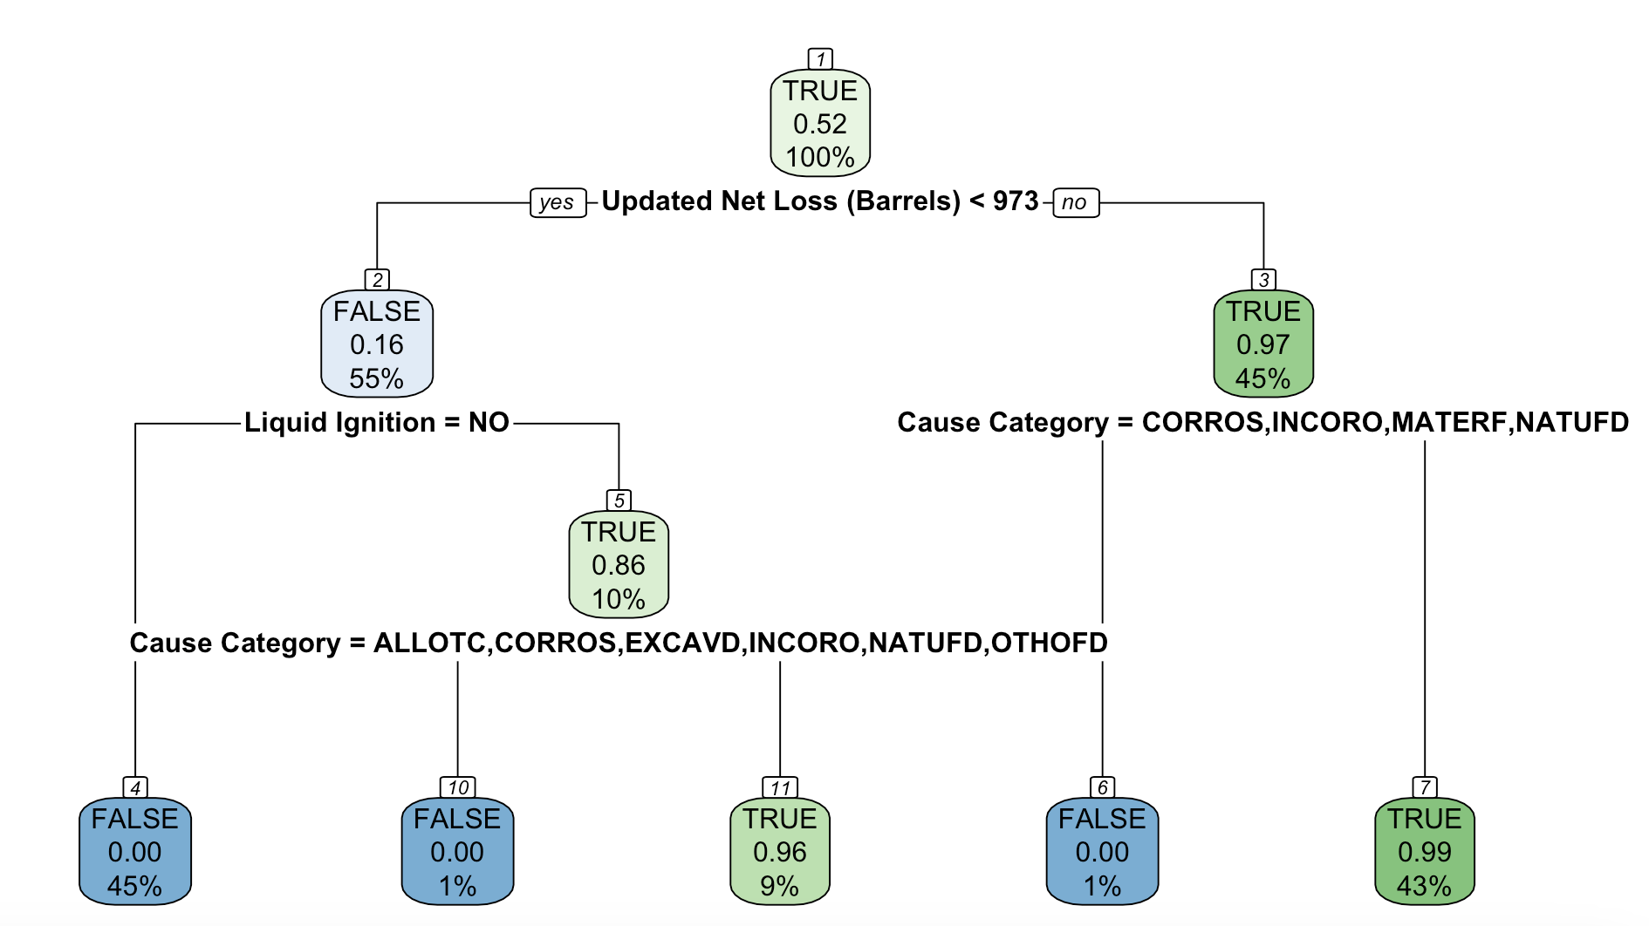
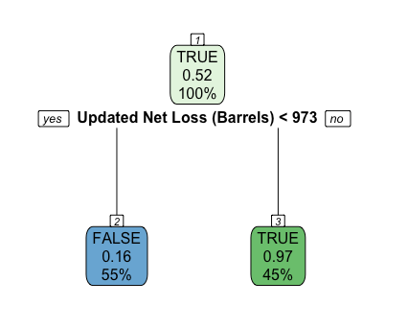

CART: Response Variable: Fatalities
Boslyn
Maximal CART
Optimal CART
Pruning
CP = 0.3447
Confusion Matrix of Test Set
 |  | Predicted
 |  | False | True
Actual | False | 807 | 29
 | True | 1 | 1
Variable Importance (in order of importance):
Updated Net Loss (Barrels)
Shutdown Duration (Hours)
Cause Category

Slide 31
Logistic Regression: Response Variable - Injuries
Boslyn
Criteria to define factors as statistically significant and has a positive relationship with Fatalities:
P-value: < 0.001
Coefficient in logistic regression > 0
Statistically significant factors:
Cause Category: Incorrect operation
Liquid Subtype: HVL or other flammable or toxic fluid, gas
Confusion Matrix of Test Set
Business Solutions
 |  | Predicted
 |  | False | True
Actual | False | 787 | 48
 | True | 0 | 4
Notes:
Need to state the conditions for statistically significant factors

Slide 32
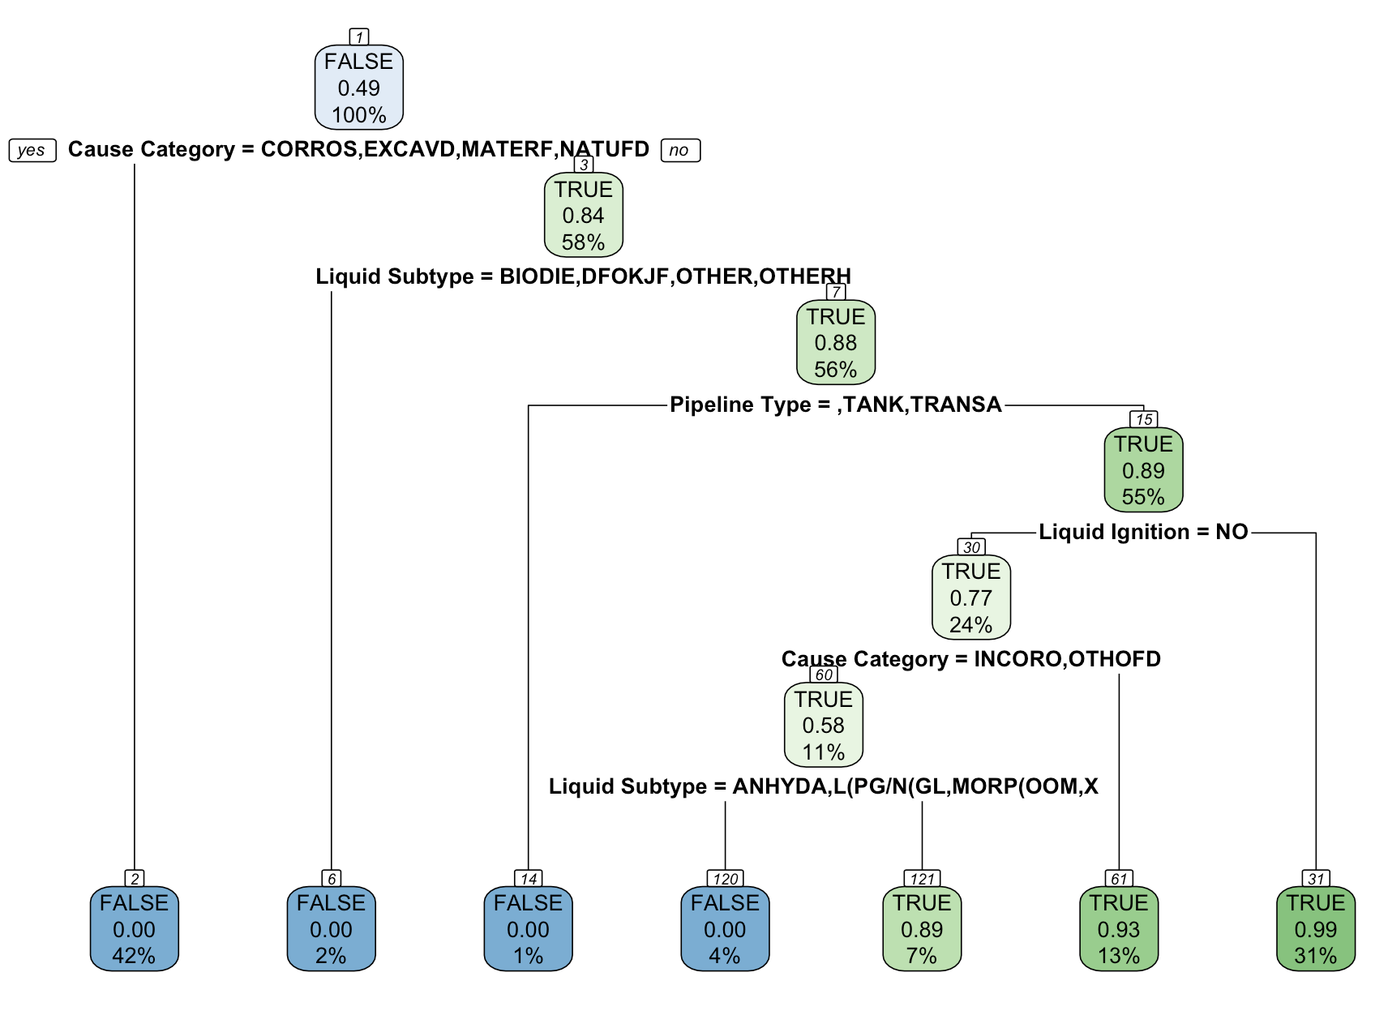
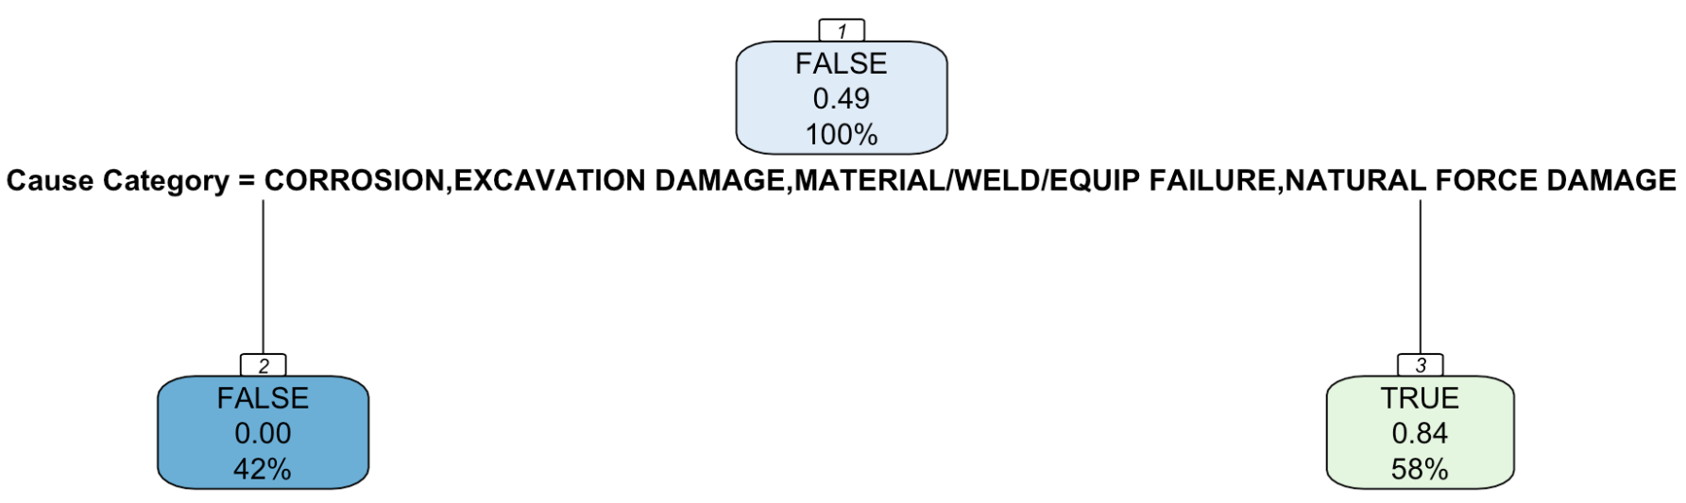
CART: Response Variable - Injuries
Boslyn
Maximal CART
Variable Importance (in order of importance):
Cause Category
Liquid Ignition
Fatalities
CP = 0.201
Pruning
Optimal CART
Confusion Matrix of Test Set
 |  | Predicted
 |  | False | True
Actual | False | 650 | 185
 | True | 2 | 2

Slide 33
Boslyn
Linear Regression: Response Variable - newcost_Percentile
Initial:
No. of variables used: 13 variables used
step()
Final:
No. of variables used: 10 variables used
Train-test Split:
Split based on newcost, then percentiles of newcost of each accident is computed
Developing Model:
After step(), no variables were removed based on VIF values as no variables suffered from multicollinearity.
Adjusted R² of model on train set = 0.27

Slide 34
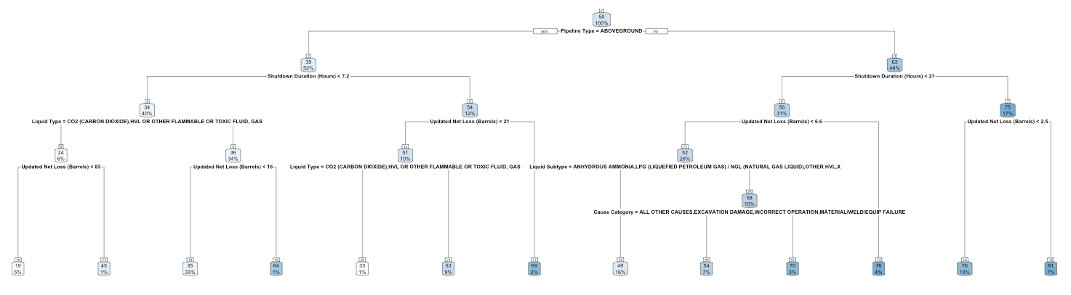
Boslyn
CART:Response Variable - newcost_Percentile
Maximal Tree:
No. of splits = 55 splits
Pruning
Optimal Tree:
No. of splits: 13 splits
Variable Importance:
Pipeline Type
Shutdown Duration (Hours)
Updated Net Loss (Barrels)
CP = 0.00499
Optimal CART

Slide 35
Boslyn
Model Evaluation & Selection
Categorical Variables
Predicted Variable | Model | Train Set |  |  | Test Set
 |  | Accuracy | True + | True - | Accuracy | True + | True -
Fatalities | Logistic Regression | 98.9% | 100% | 99% | 98.2% | 50% | 98.3%
 | CART | 96.8% | 83.3% | 96.9% | 96.4% | 50% | 96.5%
Injuries | Logistic Regression | 95.9% | 100% | 95.8% | 94.3% | 100% | 94.2%
 | CART | 81.7% | 100% | 81.6% | 77.7% | 50% | 77.8%
Main Findings:
Models are not sensitive (except logistic regression model in predicting injuries)
Models have a level of specificity.
Accuracy of models based on train and test sets are relatively similar
Logistic regression models are the better performing models in predicting the occurrence of fatalities and injuries.

Slide 36
Boslyn
Model Evaluation & Selection
Continuous Variable
Predicted Variable | Model | Train Set |  |  | Test Set
 |  | RMSE | R² |  | RMSE |  | R²
newcost (in percentile) | Linear Regression | 24.52 | 0.275 |  | 23.63 |  | 0.337
 | CART | 23.63 | 0.347 |  | 22.51 |  | 0.400
Main Findings:
The RMSE of train sets and test sets are not significantly different, thus models are not underfitted nor overfitted.
CART has lower RMSE values as compared to linear regression
R² value of CART is higher, thus a larger proportion of the variability of the predicted data is accounted for. Thus, it is a more reliable model as compared to the linear regression model in predicting percentiles of the cost of accident

Slide 37
Business Solutions
Pre-accident and Post-accident Solutions

Slide 38
Proposed Solutions
Qin Zhi
Pre-Accident: Preventative Strategies
Improved Safety Infrastructure
Training & Educational Programmes
Increased Automation
Post-Accident: Mitigative Recommendations
Risk Assessment Matrix
Tiered Emergency Responses

Slide 39
Fatality Prevention
Qin Zhi
Pre-Accident: Preventative Strategies
Predicted Variable | Most Significant Factors
Fatalities | Cause Category: OTHER OUTSIDE FORCE DAMAGE
Injuries | Cause Category: INCORRECT OPERATION Liquid Subtype: OTHER HVL Liquid Explosion: Yes
Implement infrastructural resilience
Early detection systems for seismic activity or approaching heavy machinery
Geofencing technology for critical infrastructure.
Other Outside Force Damage

Slide 40
Injury Prevention
Qin Zhi
Pre-Accident: Preventative Strategies
Predicted Variable | Most Significant Factors
Fatalities | Cause Category: OTHER OUTSIDE FORCE DAMAGE
Injuries | Cause Category: INCORRECT OPERATION Liquid Subtype: OTHER HVL Liquid Explosion: Yes
Incorrect Operation
Other HVL
Liquid Explosion
Targeted educational programs.
Simulation-based training and human factors engineering to reduce human error.
Advanced training for HVL handling, emergency response drills.
Use of robotics for routine inspections and operations.
High-sensitivity detectors and automated shutdown systems
Fire suppression technologies

Slide 41
Risk Assessment Matrix
Qin Zhi
Post-Accident: Mitigative Recommendations
Digital system uses our models to predict severity and cost
Risk score is calculated by multiplying severity and cost
Simple risk levels is intuitive and easy to use for all personnel
 |  | Predicted Severity
 |  | No Harm: 1 | Injuries Only: 2 | Fatalities: 3
Predicted Cost (in Percentile) | Cost < 25: 1 | 1 | 2 | 3
 | 25 < Cost < 75: 2 | 2 | 4 | 6
 | Cost > 75: 3 | 3 | 6 | 9

Slide 42
Tiered Emergency Responses
Qin Zhi
Post-Accident: Mitigative Recommendations
 |  | Predicted Severity
 |  | No Harm: 1 | Injuries Only: 2 | Fatalities: 3
Predicted Cost (in Percentile) | Cost < 25: 1 | 1 | 2 | 3
 | 25 < Cost < 75: 2 | 2 | 4 | 6
 | Cost > 75: 3 | 3 | 6 | 9
High Risk
E.g. Large-scale evacuations
Medium Risk
E.g. Complete plant shutdown
Low Risk
E.g. Specific machinery shut-offs

Slide 43
Expected Outcomes
Qin Zhi
Pre-accident: Fatalities and Injuries Reduction
Assuming a complete reduction the significant factors with all else equal
Calculate probability of occurrence using logistic regression model coefficients.
Injuries: - 11.46% probability
Fatalities: - 95.88% probability
However, in reality the other factors are unlikely to remain constant, and the reduction will likely be less drastic.

Slide 44


Expected Outcomes
Qin Zhi
Post-accident: Risk Assessment Matrix
Real-time outlook through current risk factors and likely outcomes
Uses early warning signs or trigger events to prevent the accidents from escalating
Easy interpretability and visualisation helps to align entire team
Allows even non-technical personnel to understand risks
Guides them to what specific actions need to be taken

Slide 45
Comparison with Existing Solutions
Qin Zhi
Current
Recommendations
Identifies and mitigates risks
Strong safety culture to protect employees
Safety reviews and annual site visits by top management
Risk assessment matrix can be a valuable addition
Fast and easy use, leading to a rapid response
Educational programmes to prevent incorrect operation are in line with current safety culture
Safety Management System
Automation
Unmanned Aerial Vehicles (UAV) to inspect high-rise equipment (e.g. flare tips) to reduce human risk
Handling HVLs using of robotics is an extension of this initiative
Expand from UAVs to other types of robotics.
Notes:
Identifies and mitigates risks
Strong safety culture to protect employees
Safety reviews and annual site visits by top management
Risk assessment matrix can be a valuable addition to the current safety protocols and management system as it allows for a fast and easy use, leading to a rapid response from personnel during accidents. Furthermore, educational programmes to prevent incorrect operation of equipment are also inline with their current safety culture’s aims.
Automation
Unmanned Aerial Vehicles (UAV) to inspect high-rise equipment (e.g. flare tips) to reduce human risk
Handling Highly Volatile Liquids using of robotics is aligned with this aim.
Expand from UAVs to other types of robotics.

Slide 46
Comparison with Existing Solutions
Qin Zhi
Current
Recommendations
Data-driven Lifesaving Rules
Covers the 8 most hazardous activities at the company.
CART model’s variables can also be used to add on to current lifesaving rules
Improves efficacy
Lifesaving Rules
`Other Outside Force Damage`
No public initiatives found
Infrastructural upgrades
Early detection sensors

Slide 47


Limitations
Qin Zhi
Data Specificity
Highly Imbalanced Data
No public data for Aramco & used United States pipeline accidents.
Might not be reflective of Aramco due to differences in companies and locations
Could have more factors that affect accidents but are not found in our dataset.
Highly Imbalanced Data
Only a few observations of data having any injuries or fatalities.
Models predictions may be inaccurate
Significant factors that influence fatalities and injuries could be inaccurate
Future Improvements:
Data from Aramco for their accidents → Accurate models for Aramco accidents

Slide 48
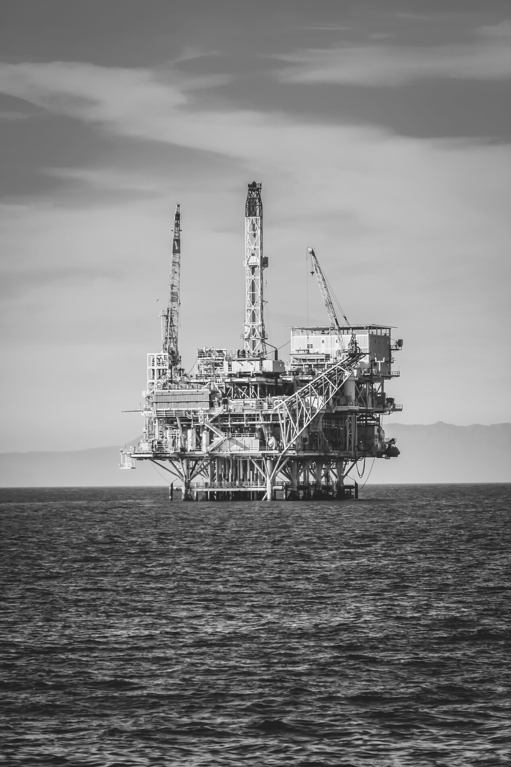
Thank you!

